Slide 1
Pandas
Introduction to Pandas syntax and operators
Acknoweldgment :Anthony D. Joseph and Fernando Pérez
(content by Josh Hug, F. Pérez)

Slide 2
Pandas Data Structures: Data Frames, Series, and Indices

Slide 3
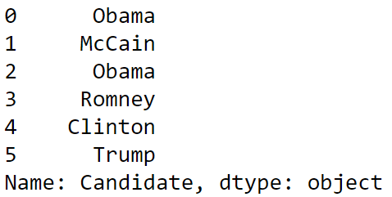
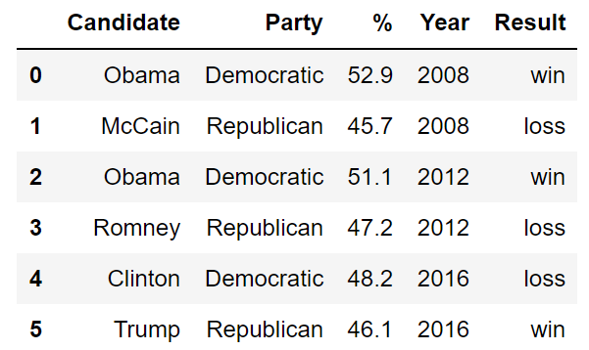
Pandas Data Structures
There are three fundamental data structures in pandas:
Data Frame: 2D data tabular data.
Series: 1D data. I usually think of it as columnar data.
Index: A sequence of row labels.
Series
Data Frame
Index

Slide 4
The Relationship Between Data Frames, Series, and Indices
We can think of a Data Frame as a collection of Series that all share the same Index.
Candidate, Party, %, Year, and Result Series all share an index from 0 to 5.
Candidate Series
Party Series
% Series
Year Series
Result Series
Non-native English speaker note: The plural of “series” is “series”. Sorry.

Slide 5
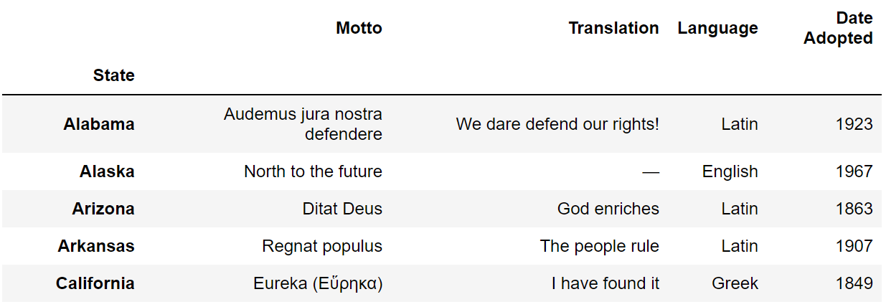
Indices Are Not Necessarily Row Numbers
Indices (a.k.a. row labels) can also:
Be non-numeric.
Have a name, e.g. “State”.

Slide 6
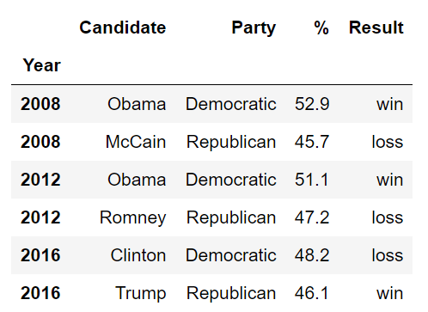
Indices
The row labels that constitute an index do not have to be unique.
Left: The index values are all unique and numeric, acting as a row number.
Right: The index values are named and non-unique.

Slide 7
Column Names Are Usually Unique!
Column names in Pandas are almost always unique!
Example: Really shouldn’t have two columns named “Candidate”.

Slide 8
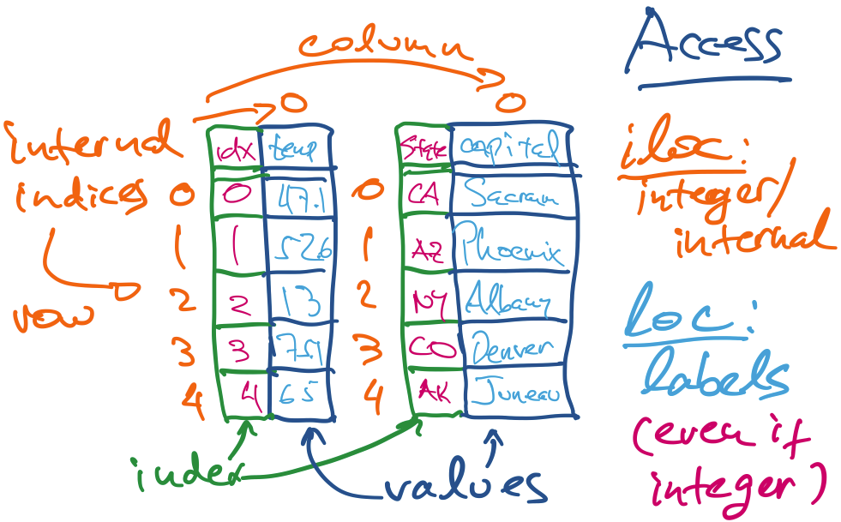
Summary: structure of a Series

Slide 9
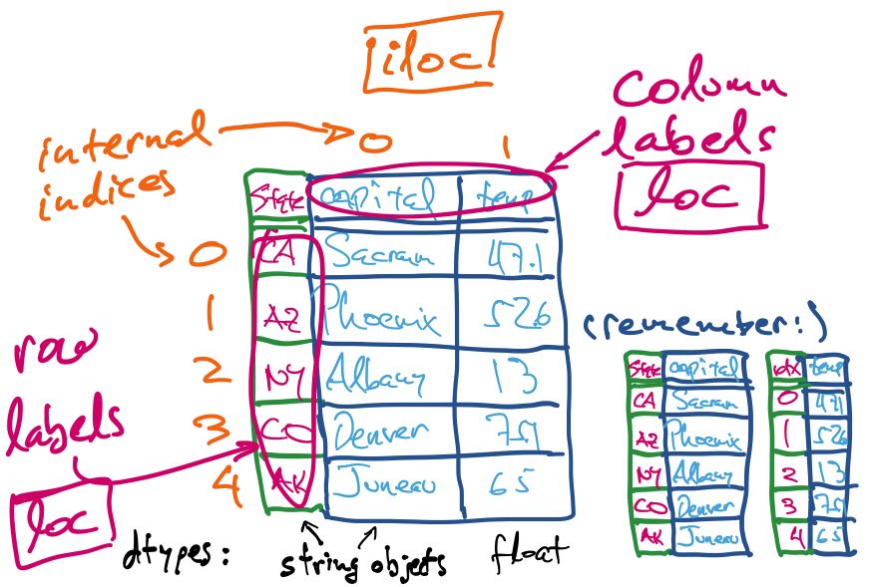
Summary: structure of a DataFrame

Slide 10
Indexing with The [] Operator
Notes:
7 minutes

Slide 11
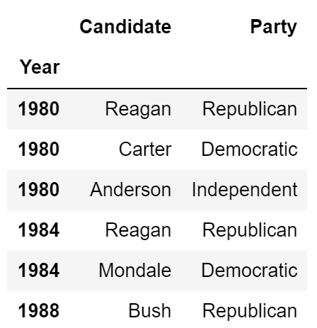
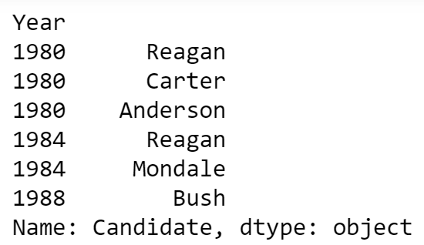
Indexing by Column Names Using [] Operator
Given a dataframe, it is common to extract a Series or a collection of Series. This process is also known as “Column Selection” or sometimes “indexing by column”.
Column name argument to [] yields Series.
List argument to [] yields a Data Frame.

Slide 12
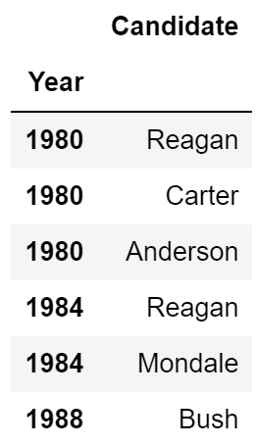
Indexing by Column Names Using [] Operator
Given a dataframe, it is common to extract a Series or a collection of Series. This process is also known as “Column Selection” or sometimes “indexing by column”.
Column name argument to [] yields Series.
List argument (even of one name) to [] yields a Data Frame.

Slide 13

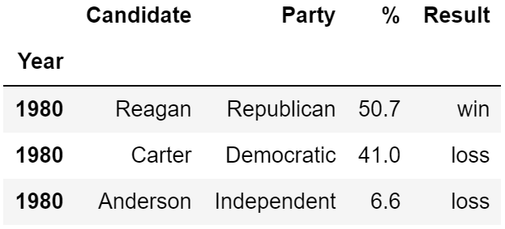
Indexing by Row Slices Using [] Operator
We can also index by row numbers using the [] operator.
Numeric slice argument to [] yields rows.
Example: [0:3] yields rows 0 to 2.

Slide 14
[] Summary
Name
[]
Series
Single Column Selection
List
[]
DataFrame
Multiple Column Selection
Numeric Slice
[]
DataFrame
(Multiple) Row Selection

Slide 15
Note: Row Selection Requires Slicing!!
elections[0] will not work unless the elections data frame has a column whose name is the numeric zero.
Note: It is actually possible for columns to have names that are non-String types, e.g. numeric, datetime etc.

Slide 16
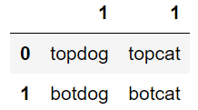
Question
Try to predict the output of the following:
weird[1]
weird[“1”]
weird[1:]
Name
[]
Series
Single Column Selection
List
[]
DataFrame
Multiple Column Selection
Numeric Slice
[]
DataFrame
(Multiple) Row Selection

Slide 17
Boolean Array Selection
and Querying
Notes:
10 min

Slide 18

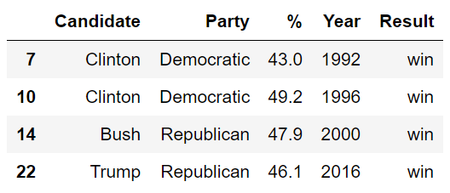
Boolean Array Input
Boolean Series can be combined using the & operator, allowing filtering of results by multiple criteria.

Slide 19
Indexing with .loc and .iloc
Sampling with .sample
Notes:
15 min

Slide 20
Loc and iloc
Loc and iloc are alternate ways to index into a DataFrame.
They take a lot of getting used to! Documentation and ideas behind them are quite complex.
I’ll go over common usages (see docs for weirder ones).
Documentation:
loc: https://pandas.pydata.org/pandas-docs/stable/generated/pandas.DataFrame.loc.html
iloc: https://pandas.pydata.org/pandas-docs/stable/generated/pandas.DataFrame.iloc.html
More general docs on indexing and selecting: Link

Slide 21
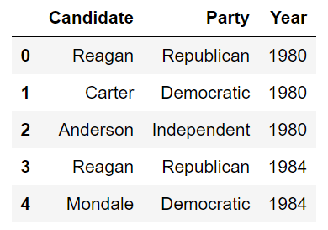
Loc with Lists
The most basic use of loc is to provide a list of row and column labels, which returns a DataFrame.

Slide 22
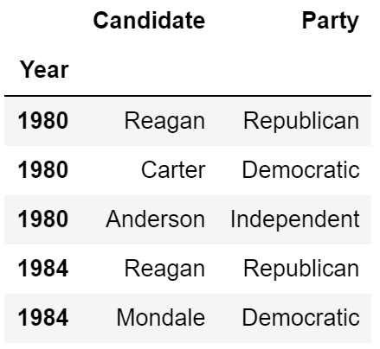
Loc with Lists
The most basic use of loc is to provide a list of row and column labels, which returns a DataFrame.

Slide 23
Loc with Slices
Loc is also commonly used with slices.
Slicing works with all label types, not just numeric labels.
Slices with loc are inclusive, not exclusive.

Slide 24
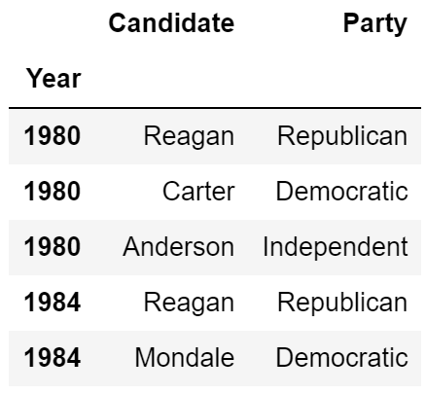
Loc with Slices
Loc is also commonly used with slices.
Slicing works with all label types, not just numeric labels.
Slices with loc are inclusive, not exclusive.

Slide 25
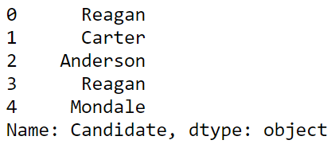
Loc with Single Values for Column Label
If we provide only a single label as column argument, we get a Series.

Slide 26
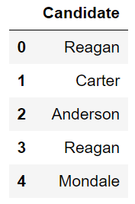
Loc with Single Values for Column Label
As before with the [] operator, if we provide a list of only one label as an argument, we get back a dataframe.

